Slide 1
Microwave Devices E511
Lecture 8
Amr Al.Awamry

Slide 2
Agenda
λ/2 Transmission line resonators
λ/4 transmission line resonators
Rectangular cavities
Circular cavities

Slide 3
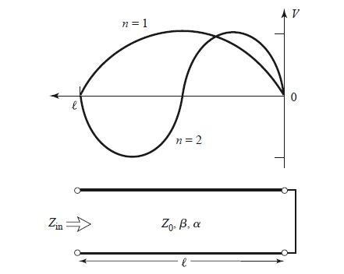
TRANSMISSION LINE RESONATORS
Short-Circuited λ/2 Line

Slide 4
Short-Circuited λ/2 Line

Slide 5
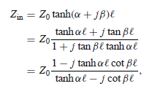
Short-Circuited λ/4 Line
// resonance cit

Slide 6
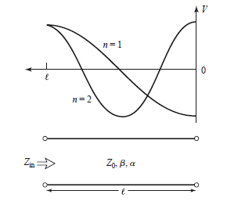
Open-Circuited λ/2 Line

Slide 7
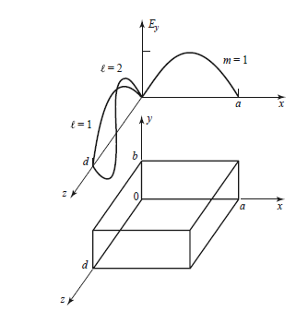
Rectangular Cavity

Slide 8
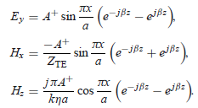
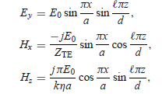
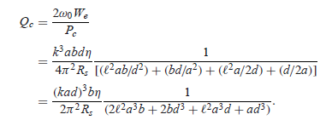
Unloaded Q of the TE_{10L} Mode
Plz check ex.6.3 P287

Slide 9
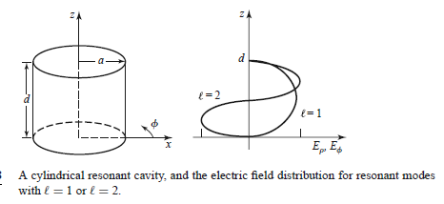
CIRCULAR WAVEGUIDE CAVITY RESONATORS
TE mode
TM mode

